Slide 1
The Challenges of using SAST for Validation and Verification and Code Coverage Information for SAST
Arthur Hicken – Parasoft
Arthur.hicken@parasoft.com
May 1, 2019
Notes:
The challenges of using SAST for Validation and Verification
IoT cybersecurity needs are driving a push to have better device certification for smart devices from home appliances to software embedded in autonomous cars. The problem is that currently there are several issues that prevent SAST from being used safely for validation and verification. In order to have strong software security that is demonstrable and auditable, there are changes that need to be made in the standards, tools, and policies currently in use.

Slide 2
The Challenge
IoT and functional safety driving software in more places
Hardware has a strict certification regime
Software does not
Software isn’t really engineering

Slide 3
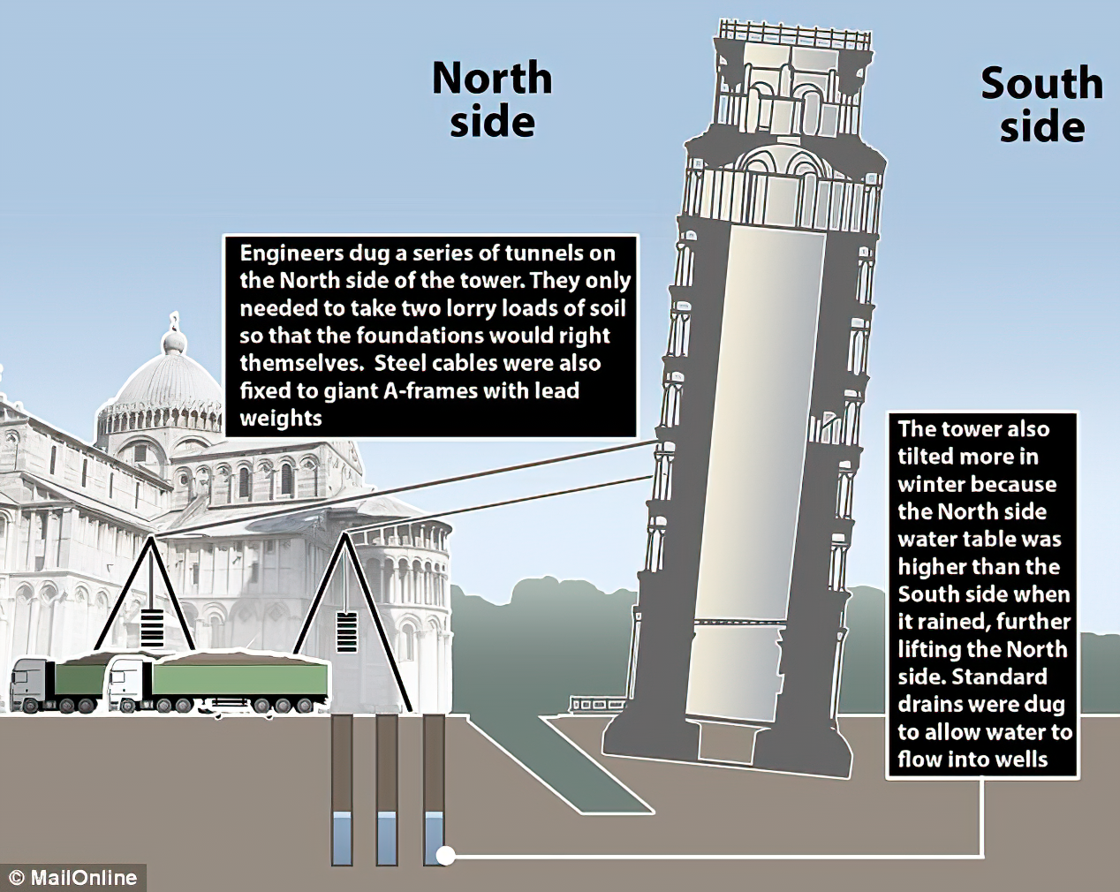
The purpose of coding standards
Static Analysis is how you enforce them
Runtime error detection
Flow analysis
Preventative standard
Uninitialized memory example
Runtime will find it IF the test suite is thorough
Flow analysis may find it depending on complexity
Pattern to prevent: Initialize variables upon declaration
Some standards are designed to detect
Others to prevent
Notes:
MISRA Example

Slide 4
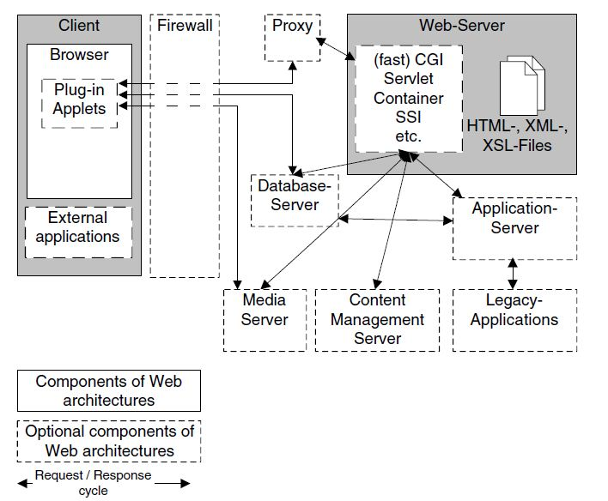
Vulnerability workflow example
Detect the error
Load testing shows leaking connections to the database
Find the cause
Open connections aren’t being closed, causing resource leaks
Locate the point in production that caused the error
Developer has forgotten to close db connections upon client termination
Implement preventative process
Use a coding standard to ensure each open connection is closed before exit
Monitor the process
Use static analysis to enforce the standard
Add regression test
Add a test to see the problem was fixed and doesn’t return

Slide 5
Heartbleed example
MISRA C 2004 20.3
“The validity of values passed to library functions shall be checked”
CWE-20
“Improper input validation”
CWE-114
“Process control”
CWE-125
“Out-of-bounds read”
CWE-130
“Improper handling of length parameter inconsistency”
Notes:
No flow-analysis rules until afterward - “Flavor of the month”
Existing standards address the underlying issue

Slide 6
Core static analysis challenges
Can't compare tools in any rational way
False positives (checker was just flat-out wrong)
Noise and Emotional false positives (user didn’t like/want/need the result)
Didn’t understand
Didn’t like the checker
Didn’t believe the checker
False negatives
bigger problem than false positives when it comes to standards
Unknown coverage
Unknown meaning of tool output
Safe? Didn’t check?

Slide 7
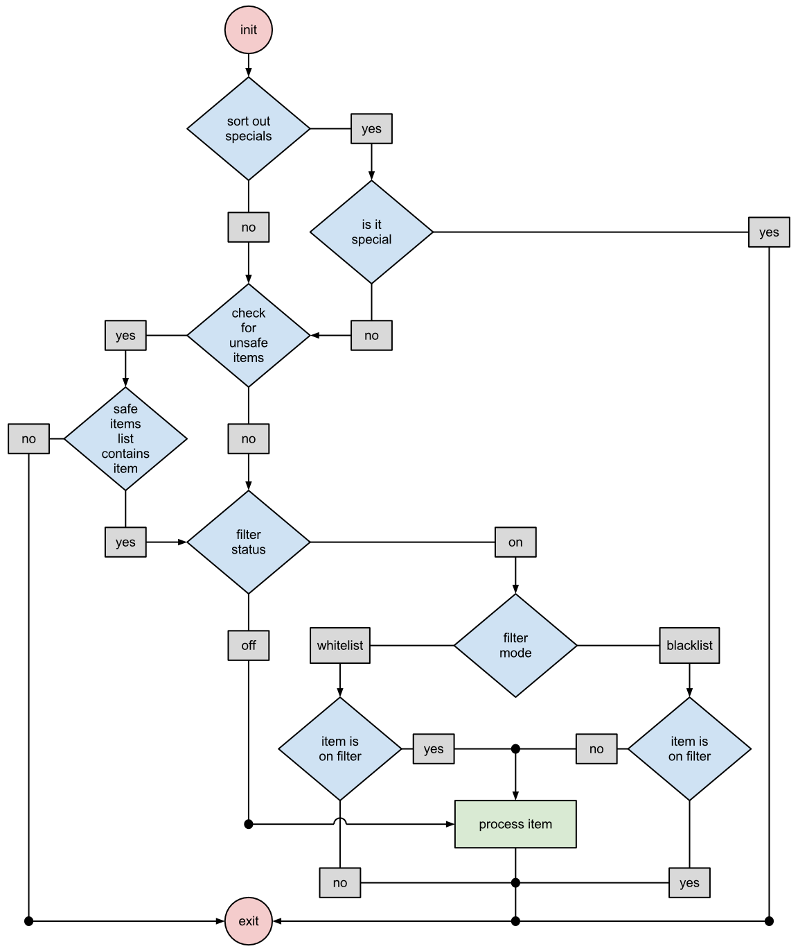
Challenges of flow-based static analysis
It’s somewhat non-deterministic
Symbolic execution
Guessing values to drive coverage
Notes:
one of the problems of static analysis for validation and verification is that people usually mean flow analysis when they say sass and that's pretty much non-deterministic

Slide 8
Normal V&V
Building and materials standards used
Easy to assess that it was done as expected
Static analysis is focused more on assuring that the code is built properly (validation), than that the functional requirements are being met (verification).

Slide 9
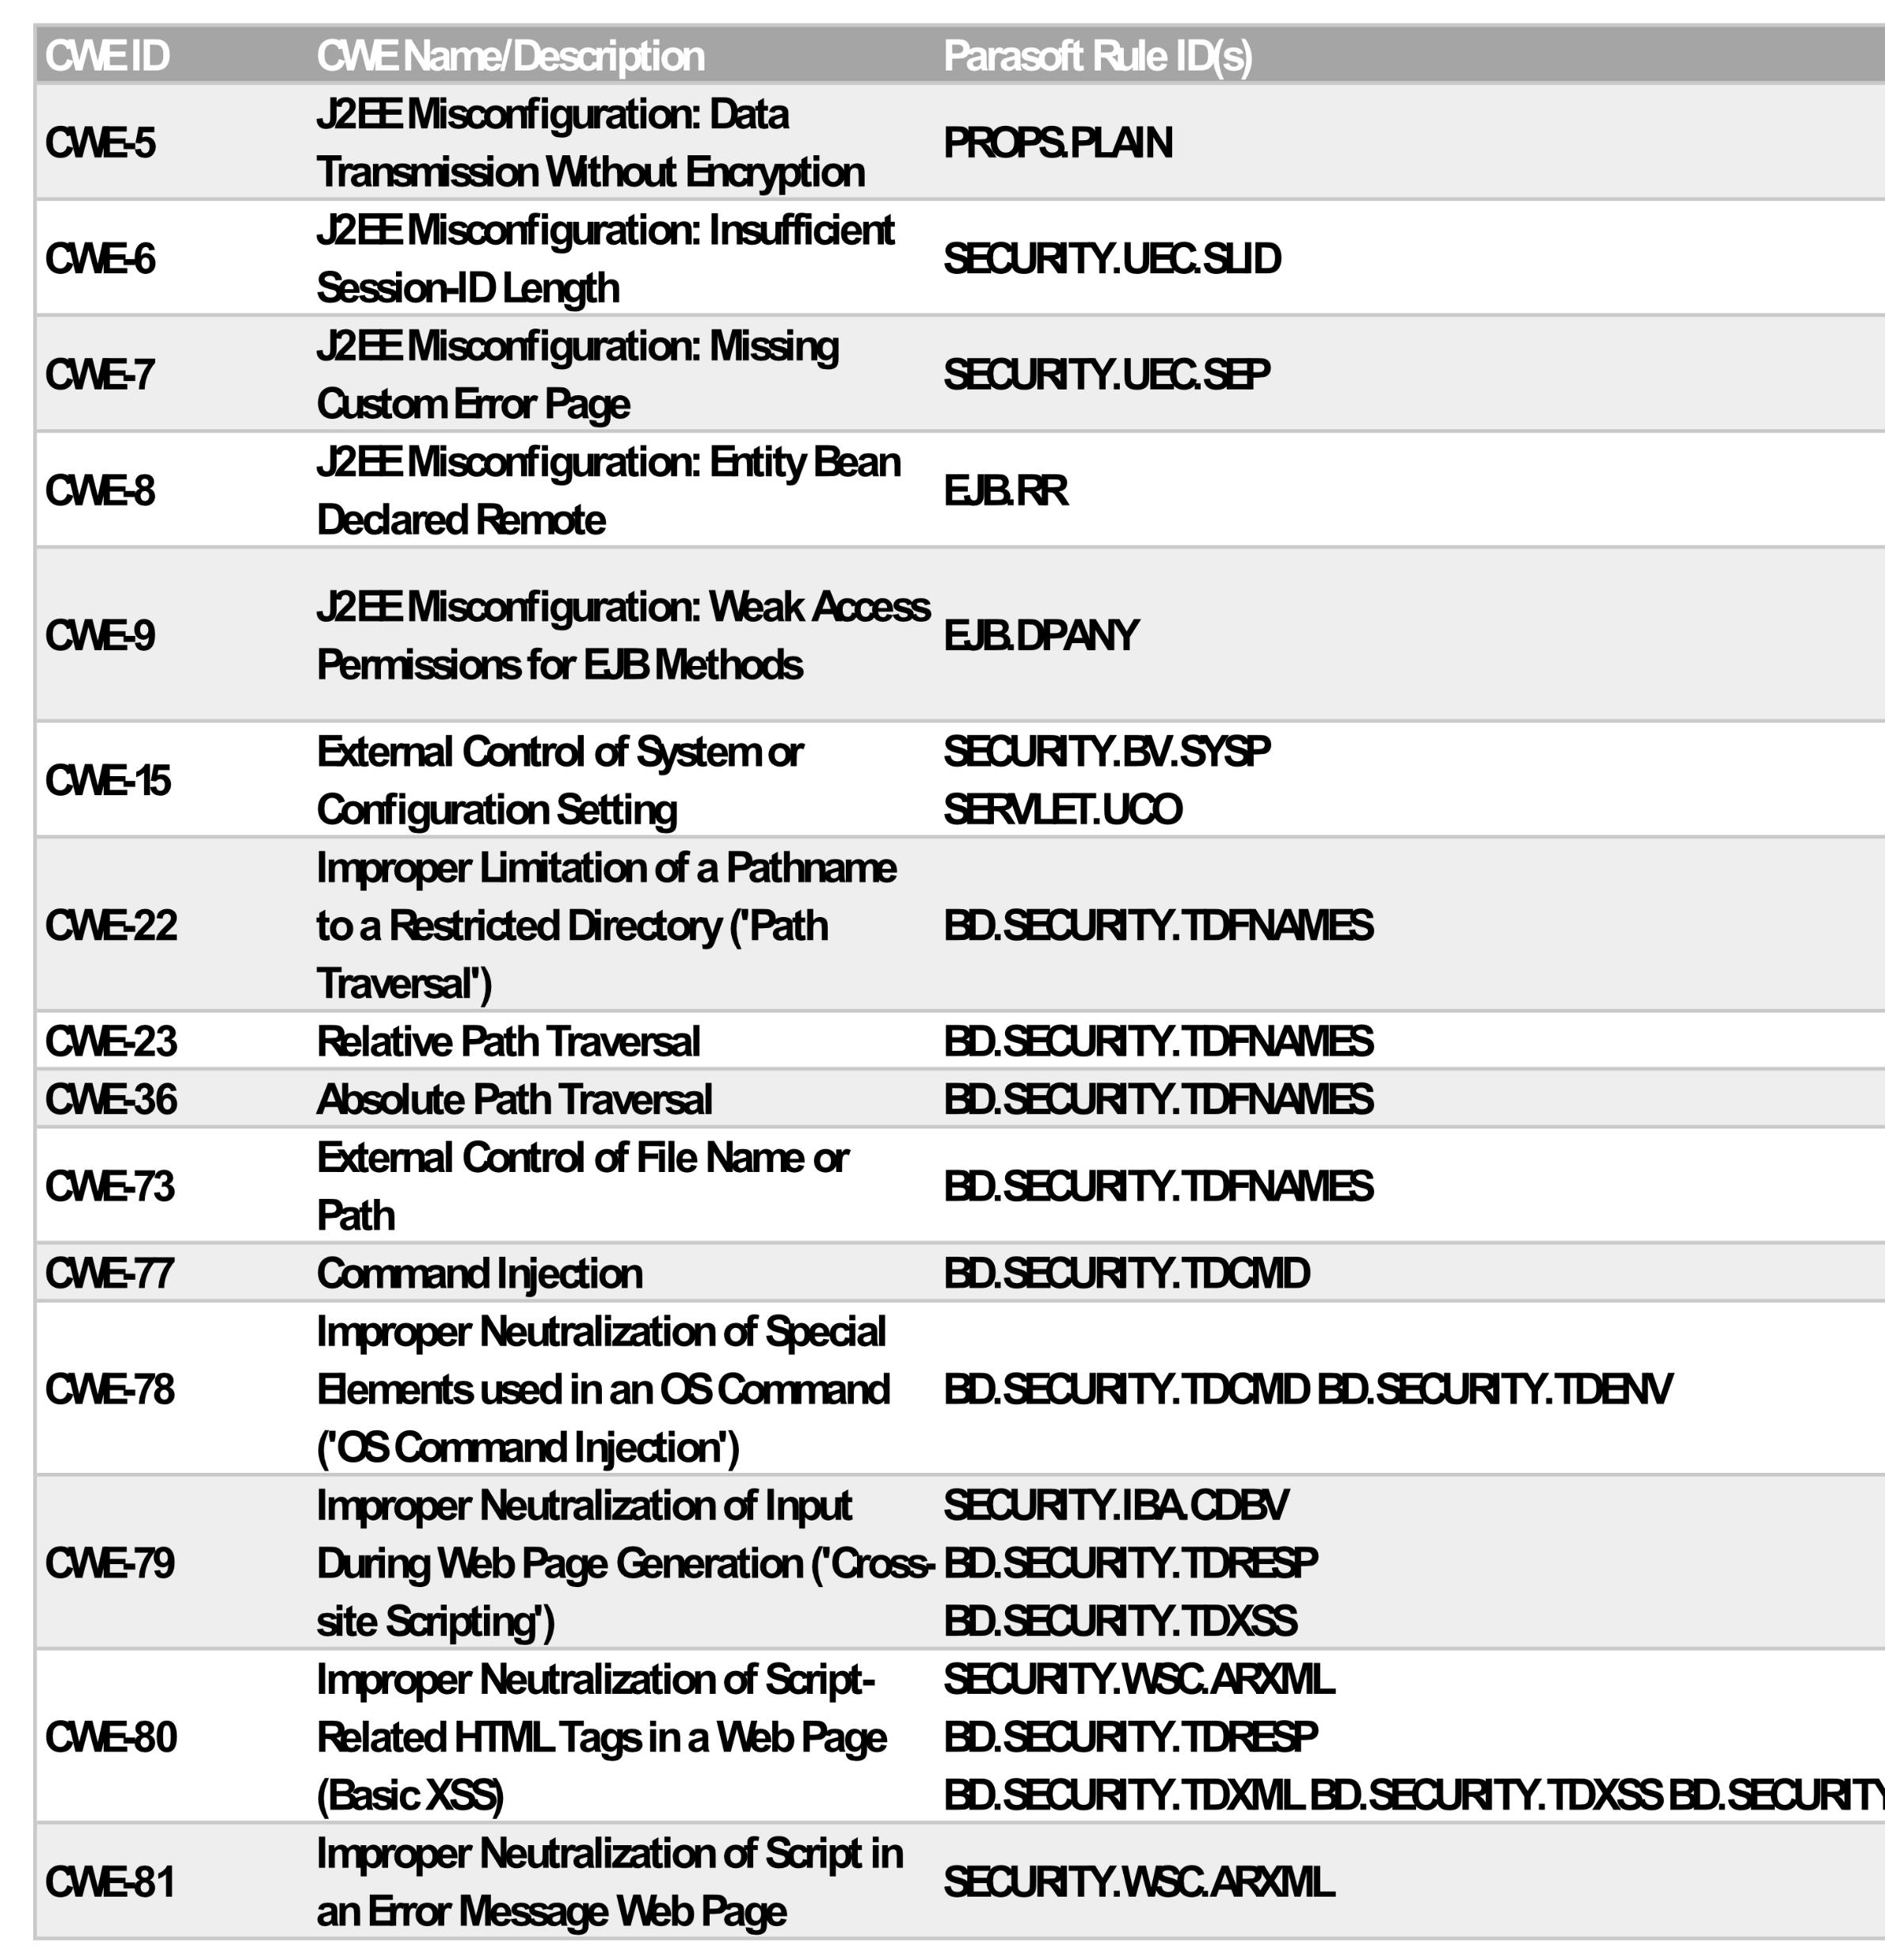
Software V&V Hurdles
What is coverage? (functional, line, etc)
What are we validating?
Functional coverage is verification
Code coverage coupled with SAST COULD be validation
Standards are ambiguous
Too many subitems
Checkers aren’t comparable between vendors, making audit impossible
Bugs we possible bugs vs smells vs lint vs standards enforcement
Rules are defined differently than tools are built
Map from tool to rule is typically many-to-many
Notes:
Verification Vs. Validation. Verification is testing that your product meets the specifications / requirements you have written. ... Validation tests how well you addressed the business needs that caused you to write those requirements. It is also sometimes called acceptance or business testing.

Slide 10
Static analysis V&V and the SBOM
What kind of software is in the final product?
Self-written
Code for hire (delivered as code)
Software for hire (delivered as executable)
OSS library
OSS source
Operating system and it’s parts
What is the proper static analysis policy, for example using CWE, for each type of code?

Slide 11
What’s to be done?
Make the standards less ambiguous (MISRA has started)
Proper sub-items
Clarification of what is decidable (detectable)
Full mapping of support between SAST tool and the standard
Including prevention vs detection rules

Slide 12
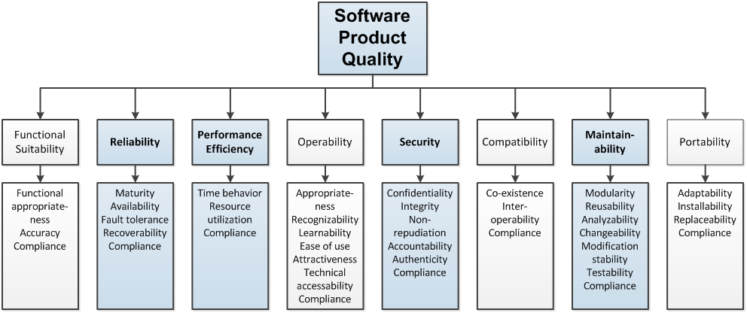
Prioritization by technical impact Which weaknesses matter most
Common Weakness Risk Analysis Framework (CWRAF)
Common Weakness Scoring System (CWSS)
DoS
Read/write data
etc
ISO 27010

Slide 13
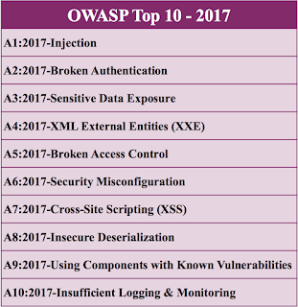
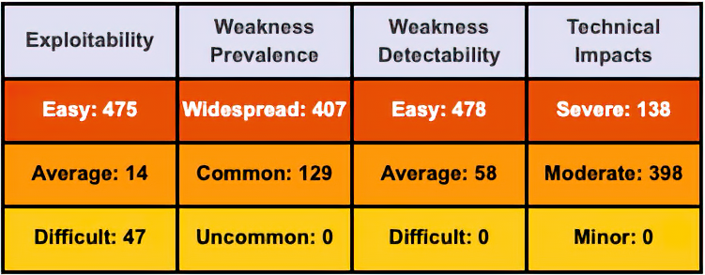
OWASP – Open Web Application Security Project
Web oriented standard
Language independent
Top 10 list
About 50 sub-items
Not all statically analyzable
Used by FDA and UL 2900
Risk scoring system
Current version 2017
https://www.owasp.org/index.php/Category:OWASP_Top_Ten_Project
Notes:
Open Web Application Security Project
Top 10 list

Slide 14
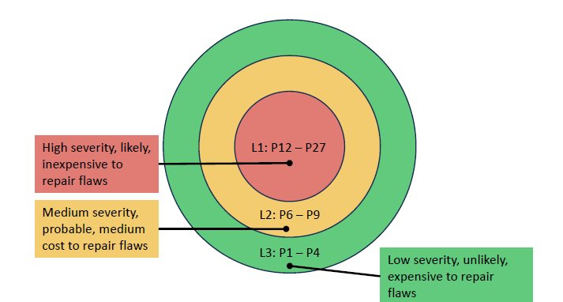
SEI / CERT Secure Coding Guidelines Software Engineering Institute / Computer Emergency Readiness Team
Developed with community involvement
Focus on engineering and prevention
Secure Coding Guidelines
Lots of static analysis rules
C, C++, Java, Perl, Android
Two categories
Rules (strict)
critical and detectable
Recommendation (less strict)
lower impact
difficult to analyze
Practical risk scoring
Likelihood, cost, severity -> priority
https://www.securecoding.cert.org

